Slide 1
COLLEGE VOTING SYSTEM

Slide 2
TABLE NAME: ADMIN
FIELD | DATA TYPE | SIZE | CONSTRAINT
admin id | Int | 10 | Primary key
Admin name | Varchar | 30 | Not null
Admin mobile | Int | 10 | Not null
Username | Varchar | 20 | Not null
Password | Varchar | 20 | Not null

Slide 3
TABLE NAME: VOTER
FIELD | DATA TYPE | SIZE | CONSTRAINT
Voter id | Int | 10 | Primary key
Voter type | Varchar | 20 | Not null
Email | Varchar | 20 | Not null
Password | Varchar | 20 | Not null
First name | Varchar | 20 | Not null
Last name | Varchar | 20 | Not null
Mobile number | Int | 10 | Not null
Address | Varchar | 30 | Not null

Slide 4
TABLE NAME: CANDIDATES
FIELD | DATA TYPE | SIZE | CONSTRAINT
Candidate id | Int | 10 | Primary key
Post | Varchar | 20 | Not null
First name | Varchar | 20 | Not null
Last name | Varchar | 20 | Not null
Mobile | Int | 10 | Not null
Email | Varchar | 20 | Not null
Address | Varchar | 30 | Not null

Slide 5
TABLE NAME: POOL
FIELD | DATA TYPE | SIZE | CONSTRAINT
Pool id | Int | 10 | Primary key
Candidate id | Int | 10 | Foreign key
Voter id | Int | 10 | Foreign key
Post id | Int | 10 | Foreign key

Slide 6
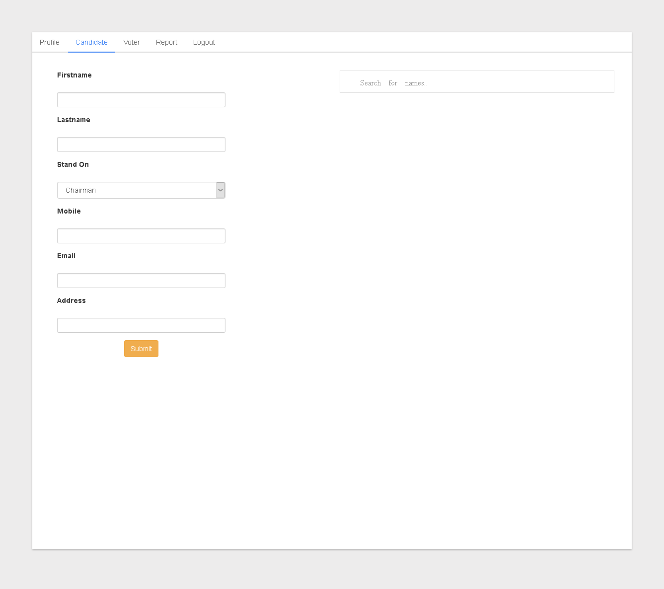

Slide 7
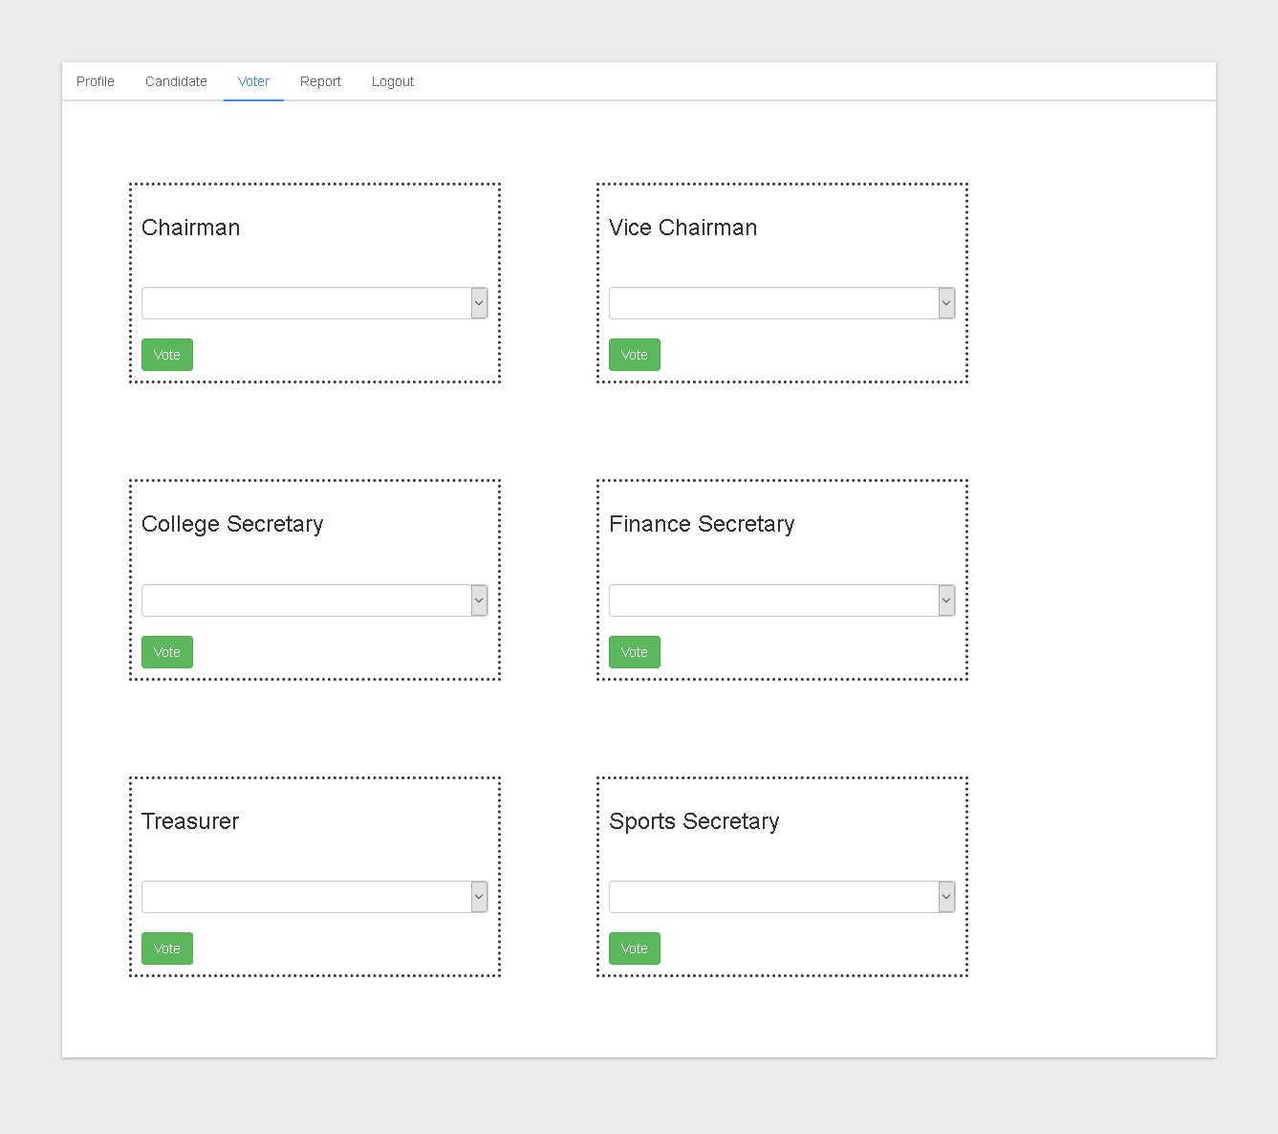

Slide 8
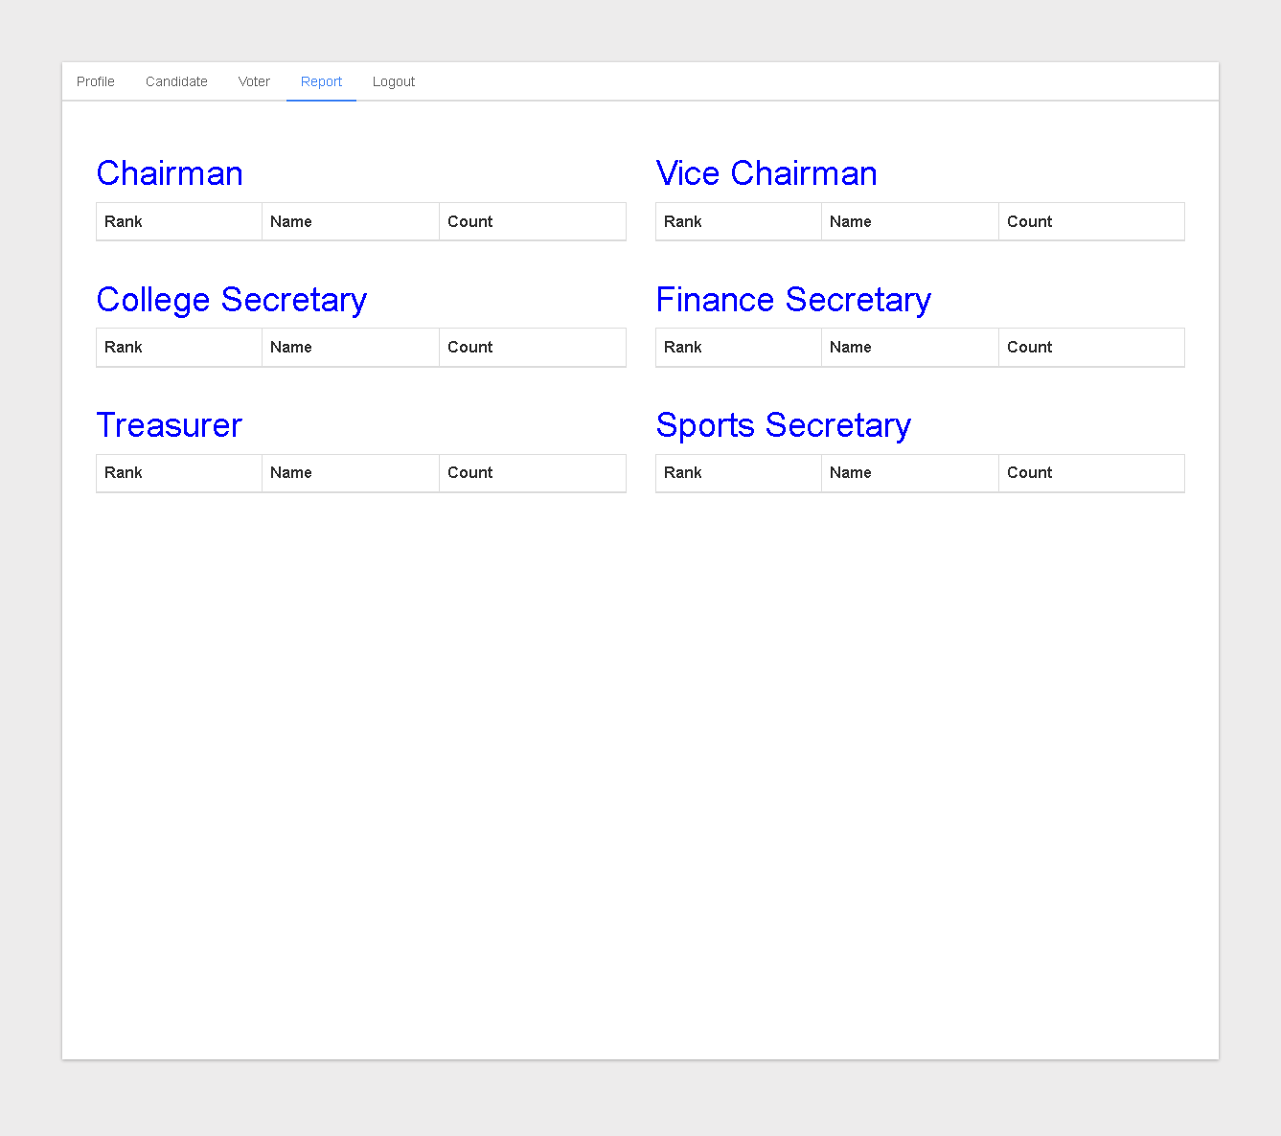

Slide 9
